Slide 1
An Electro-thermal Model for
the A123 26650 LiFePO₄ Battery
Xinfan Lin, Hector Perez, Jason Siegel, Anna G. Stefanopoulou
University of Michigan

Slide 2
Copyright
************************************************************************************
COPYRIGHT © 2013
THE REGENTS OF THE UNIVERSITY OF MICHIGAN
ALL RIGHTS RESERVED
PERMISSION IS GRANTED TO USE, COPY AND REDISTRIBUTE THIS SOFTWARE FOR NONCOMMERCIAL EDUCATION AND RESEARCH PURPOSES, SO LONG AS NO FEE IS CHARGED, AND SO LONG AS THE COPYRIGHT NOTICE ABOVE, THIS GRANT OF PERMISSION, AND THE DISCLAIMER BELOW APPEAR IN ALL COPIES MADE; AND SO LONG AS THE NAME OF THE UNIVERSITY OF MICHIGAN IS NOT USED IN ANY ADVERTISING OR PUBLICITY PERTAINING TO THE USE OR DISTRIBUTION OF THIS SOFTWARE WITHOUT SPECIFIC, WRITTEN PRIOR AUTHORIZATION. PERMISSION TO MODIFY OR OTHERWISE CREATE DERIVATIVE WORKS OF THIS SOFTWARE IS NOT GRANTED.
THIS USE OF THIS SOFTWARE REQUIRES MATLAB(TM) AND SIMULINK(TM), A LICENSED PRODUCT OF THE MATHWORKS, INC. THE SOFTWARE USER IS SOLELY RESOPNSIBLE FOR OBTAINTING AN APPROPRIATE LICENSE FOR MATLAB(TM) AND SIMULINK(TM). NO LICENSE TO MATLAB(TM) AND SIMULINK(TM) IS GRANTED, INFERRED OR IMPLIED BY THE DISTRIBUTION OF THIS SOFTWARE.
THIS SOFTWARE IS PROVIDED AS IS, WITHOUT REPRESENTATION AS TO ITS FITNESS FOR ANY PURPOSE, AND WITHOUT WARRANTY OF ANY KIND, EITHER EXPRESS OR IMPLIED, INCLUDING WITHOUT LIMITATION THE IMPLIED WARRANTIES OF MERCHANTABILITY AND FITNESS FOR A PARTICULAR PURPOSE. THE REGENTS OF THE UNIVERSITY OF MICHIGAN SHALL NOT BE LIABLE FOR ANY DAMAGES, INCLUDING SPECIAL, INDIRECT, INCIDENTAL, OR CONSEQUENTIAL DAMAGES, WITH RESPECT TO ANY CLAIM ARISING OUT OF OR IN CONNECTION WITH THE USE OF THE SOFTWARE, EVEN IF IT HAS BEEN OR IS HEREAFTER ADVISED OF THE POSSIBILITY OF SUCH DAMAGES.
************************************************************************************

Slide 3
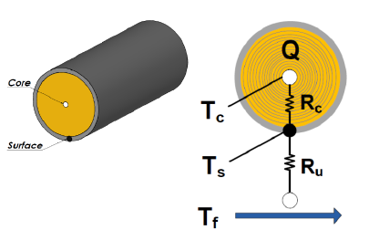
Thermal Model
Tc: core temperature
Ts: surface temperature
Tf: coolant flow temperature
Q: heat generation
Cc: heat capacity of the battery core
Cs: heat capacity of the battery surface
Rc: conduction resistance between Tc and Ts
Ru: convection resistance between Tf and Ts
Dynamics of core temperature:
Heat generation from the electrical model
Conduction between core and surface
Dynamics of surface temperature:
Conduction between core and surface
Convection between surface and coolant
Average temperature: for the temperature
dependent parameters of the electrical model

Slide 4
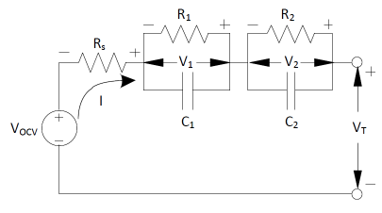
Electrical Model
Equivalent Circuit: double R-C
Coulomb counting
Voltage Relaxation:
R, C(Tm, SOC, sgn(I)
2 RC: Slow and fast
dynamics
Terminal voltage
Heat Generation
Joule Heating
Entropic Heat [1]
[1] C. Forgez, D. V. Do, G. Friedrich, M. Morcrette, and C. Delacourt, “Thermal modeling of a cylindrical LiFePO4/graphite lithium-ion battery,” J. Power Sour., vol. 195, no. 9, pp. 2961–2968, 2010.

